Slide 1
Sentiment Analysis of YouTube Comments
2410030138 KYASA GOWTHAM
2410030188 ANISH JADHAV
2410030320 V.MUKESH
2410030496 P.KARTHIKEYAN
2410030250 G.KISHORE

Slide 2
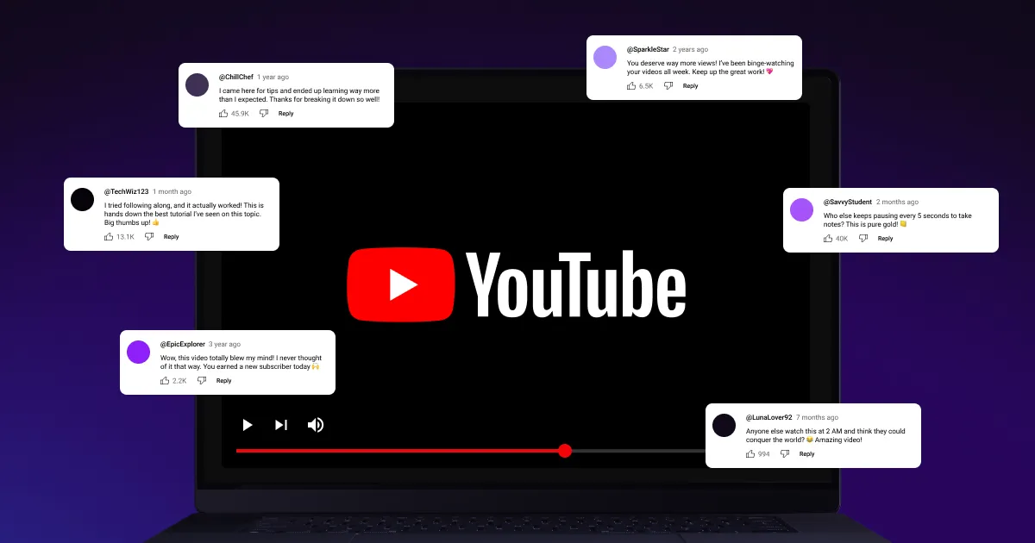
Data Collection Using YouTube API
To gather the vast amounts of public comments needed for analysis, we leverage the YouTube Data API v3. This programmatic access allows for efficient, large-scale extraction based on specific video IDs.

Slide 3
Sentiment Analysis Techniques & Tools
1
Natural Language Processing (NLP)
2
Preprocessing & Cleaning
3
Tools
The core of sentiment analysis applies advanced NLP methods to interpret human language within comments.
Crucial steps include filtering irrelevant comments, removing noise like URLs, and handling emojis to ensure data quality.
Basic Python – for cleaning and preparing text.
VADER – checks if comments are positive, negative, or neutral.
Emoji package – helps understand emoji feelings.

Slide 4




EXPECTED OUTCOME
Content Enhancement
Crisis Prevention
Identifies what viewers like or dislike.
Make better videos using viewer feedback.
Detect and respond early to negative feedback that could damage reputation.Protects reputation, avoids backlash
Marketing Intelligence
Automated Tracking
Identifies what products or services people are talking about positively/negatively.
Using software to automatically check and understand comment sentiments (positive, negative, or neutral) over time.

Slide 5
Future Scope
Better Understanding of Large Audiences
As more people comment on videos, sentiment analysis can help
creators and brands understand public opinion on a larger scale.
Handling Complex Language
YouTube comments often include slang, sarcasm, and emojis. Future systems will better at understand these tricky parts.
Smarter AI Analysis
AI can be used to analyze comments in real time, helping creators respond quickly and improve content based on viewer feedback.

Slide 6
SUMMARY
This research focuses on classifying YouTube comments into positive, negative, or neutral categories to analyze public opinion trends and their link to real-world events. A dataset of 1,500 annotated sentences was preprocessed using techniques like stopword and punctuation removal, lemmatization, and feature extraction through unigram, bigram, and trigram models. Six machine learning classifiers—Naïve Bayes, Support Vector Machine (SVM), Logistic Regression, Decision Tree, K-Nearest Neighbour, and Random Forest—were implemented, with performance measured using accuracy, Macro-F Score, and Micro-F Score. SVM achieved the highest accuracy overall, followed by Naïve Bayes and Random Forest, while unigram features provided the most consistent results. The study highlights that effective text preprocessing and feature selection can significantly enhance sentiment classification, and suggests future improvements through larger multilingual datasets, deep learning models, and real-time sentiment monitoring systems.
Drawbacks
It looked at old comments, not new ones as they come in.
The study used only a small amount of data (1,500 sentences), so it might not work well on lots of different comments.
The data came from formal sentences, not from real YouTube comments that have slang and emojis.
It only understands English, not other languages.
It used old methods that might miss things like jokes or mixed feelings.
It used simple ways to understand words and didn’t try newer, smarter techniques.

Slide 7
THANK YOU!

